Slide 1
COMP-3150 COVID-19
Database Project
Group Members:
Ben Chittle
Danielle Nguyen
Najia Shinneeb

Slide 2
01
03
Overview
Schema
CONTENTS
02
ER Diagram
04
05
Database Design
Queries

Slide 3
01
Overview

Slide 4
Database Goals
Our goal was to construct a database that would manage data based on the following principles (from project outline):
COVID-19 Hospitalization and ICU information (both provincial and according to health regions)
COVID-19 testing (including positivity rate)
COVID-19 age-wise breakdown of the positive cases
COVID-19 vaccine data (ONLY adults but age-wise)

Slide 5
02
ER Diagram

Slide 6
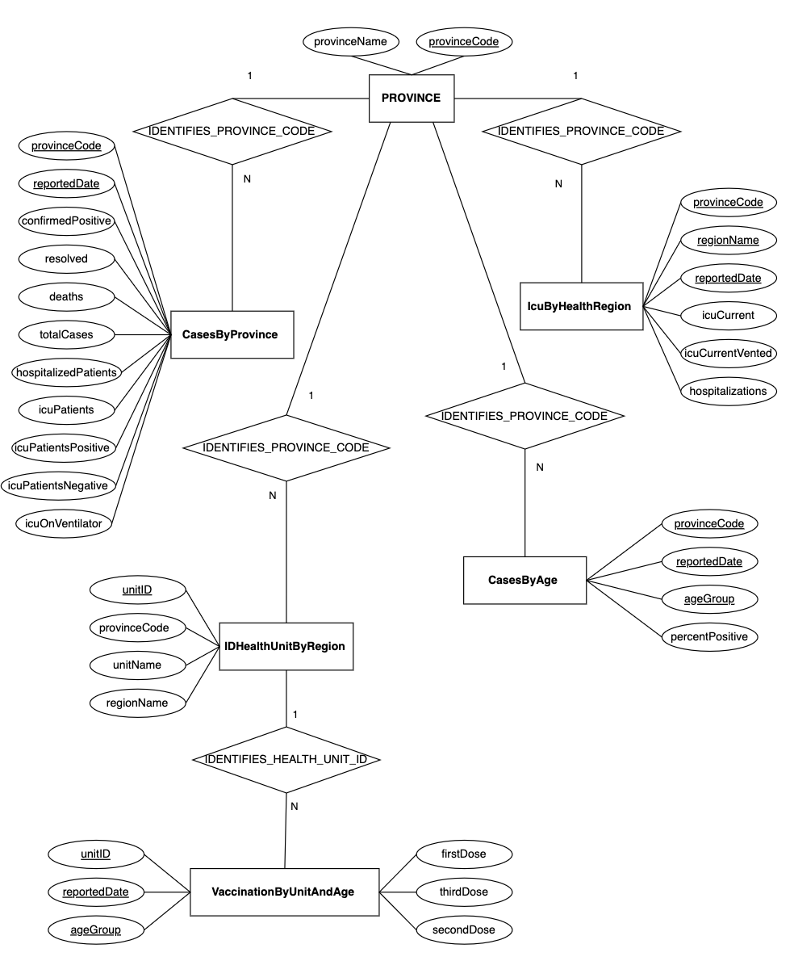
ER Diagram
Modified accordingly to our database
Six entities
Five relationships

Slide 7
03
Relational Schema

Slide 8
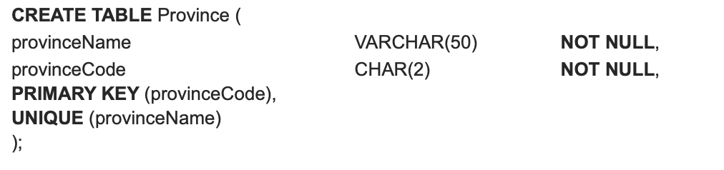
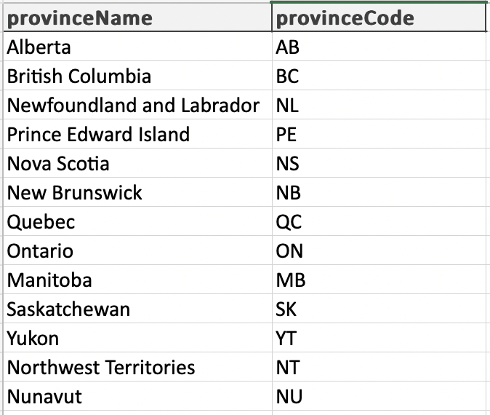
Table Province
This Table Contains:
All province names and province codes in Canada
Primary Key: Province Code
Also used as a Foreign key in the other tables (to distinguish data by province)
Normalization note:
✓ INF: cells contain single value
✓ 2NF: single-attribute primary key
✓ 3NF: no transitive dependency

Slide 9
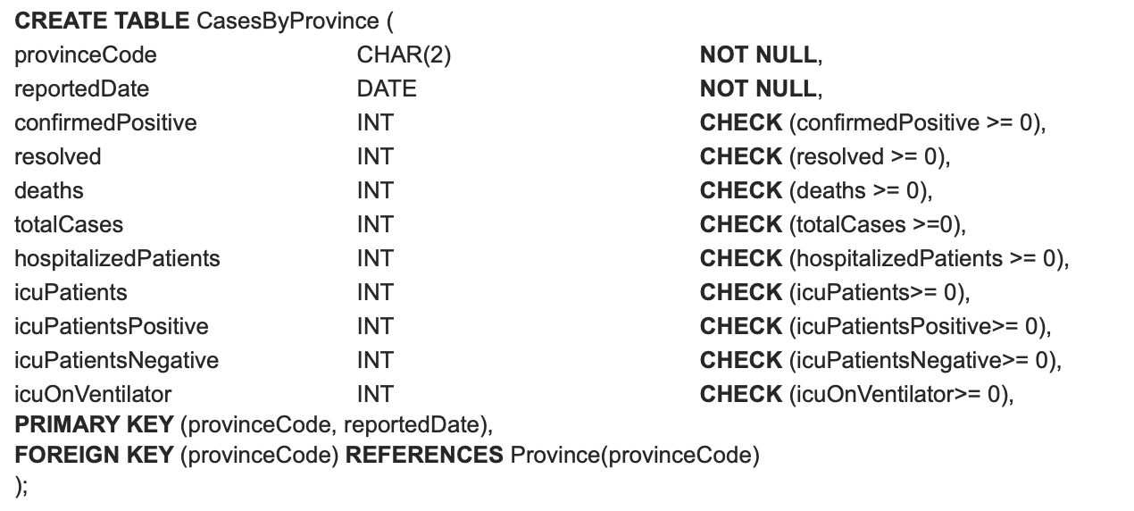
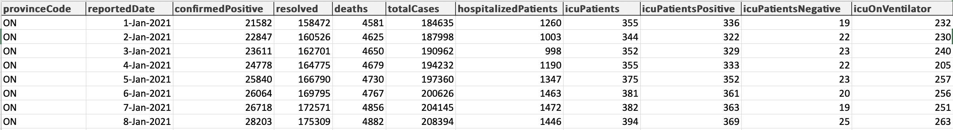
Table CasesByProvince
This Table Contains:
Information about COVID-19 case numbers and ICU for the whole province
Primary Key:
Province Code (from Province)
Reported Date
Normalization note:
✓ INF: cells contain single value
✓ 2NF: non-key attributes have no partial dependency
✓ 3NF: no transitive dependency

Slide 10
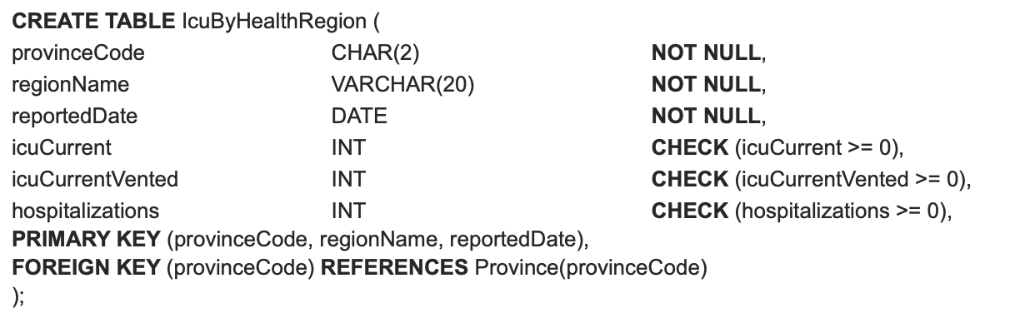
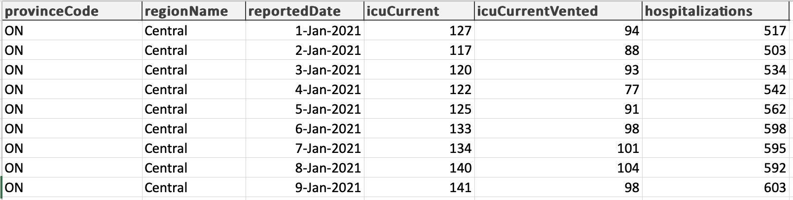
Table IcuByHealthRegion
This Table Contains:
Information on COVID-19 ICU and hospitalization for each provincial region
Primary Key:
Province Code (from Province)
Provincial Regions
Reported Date
Normalization note:
✓ INF: cells contain single value
✓ 2NF: non-key attributes have no partial dependency
✓ 3NF: no transitive dependency

Slide 11
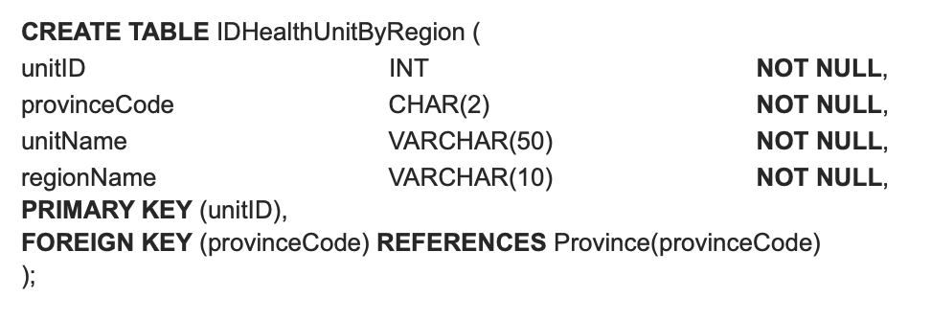
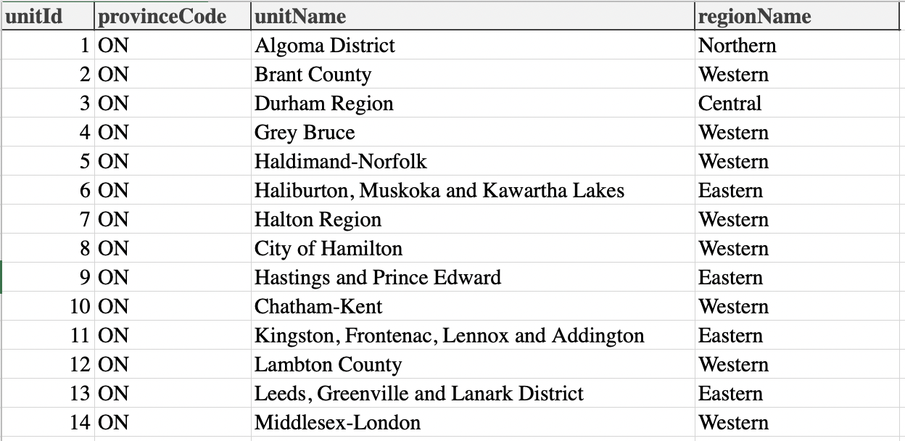
Table IDHealthUnitByRegion
This Table Contains:
Health Unit Names and their corresponding Region Names
Primary Key: Unit ID
Foreign Key: Province Code (from Province)
Normalization note:
✓ INF: cells contain single value
✓ 2NF: single-attribute primary key

Slide 12
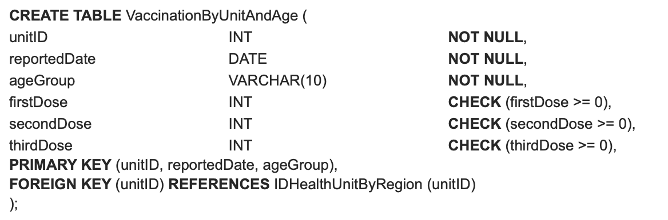
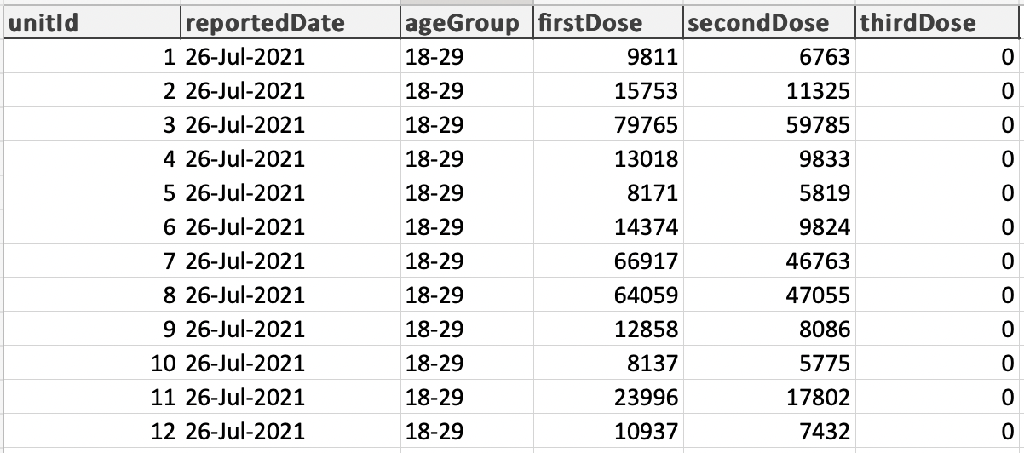
Table VaccinationByUnitAndAge
This Table Contains:
Daily information on COVID-19 vaccination rates for each age group in every provincial health unit
Primary Key:
Unit ID (from IDHealthUnitByRegion)
Reported Date
Age Group
Normalization note:
✓ INF: cells contain single value
✓ 2NF: non-key attributes have no partial dependency
✓ 3NF: no transitive dependency

Slide 13
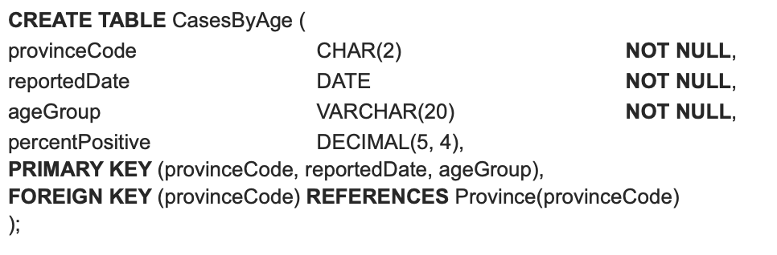
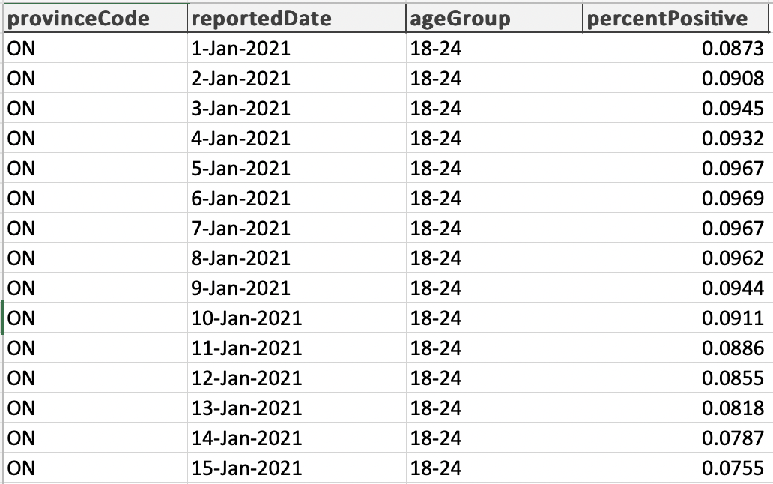
Table CasesByAge
This Table Contains:
Daily information on percent positive cases for adults per province
Primary Key:
Province Code (from Province)
Reported Date
Age
Normalization note:
✓ INF: cells contain single value
✓ 2NF: non-key attributes have no partial dependency
✓ 3NF: no transitive dependency

Slide 14
04
Database Design

Slide 15
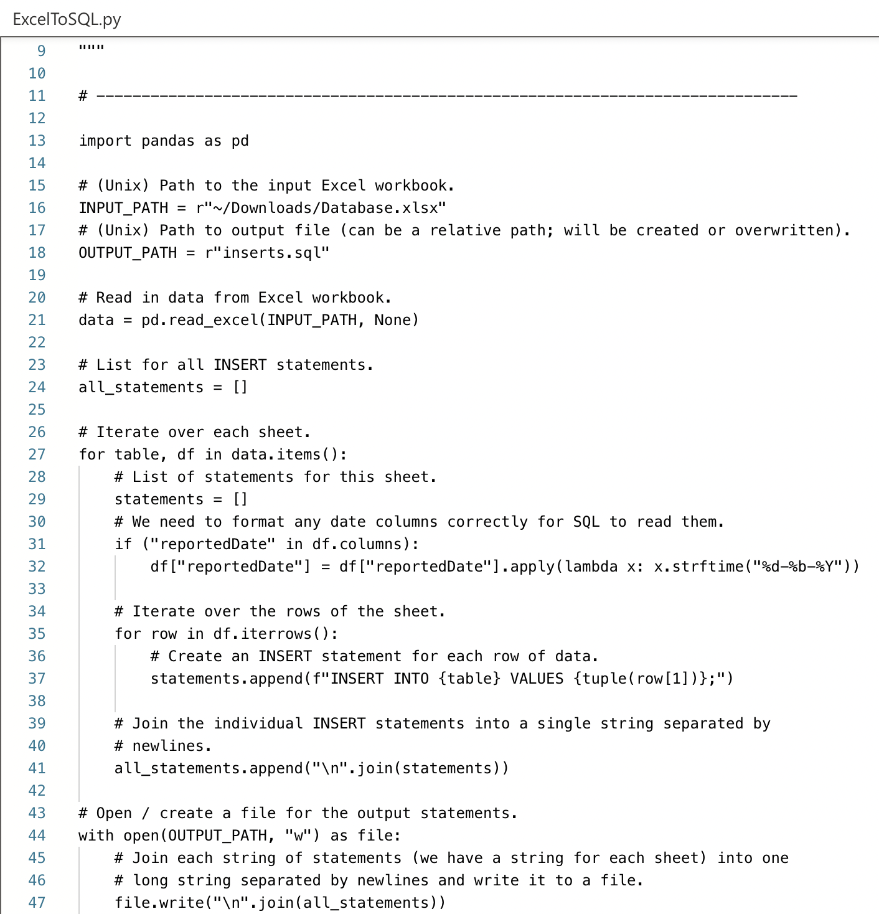
Excel to SQL Queries (ExcelToSQL.py)
Excel data populated using data from Ontario governmental website
Custom Python script that transforms data in an Excel sheet into INSERT statements
Output is a .sql file that can be imported in SQLPLUS Server

Slide 16
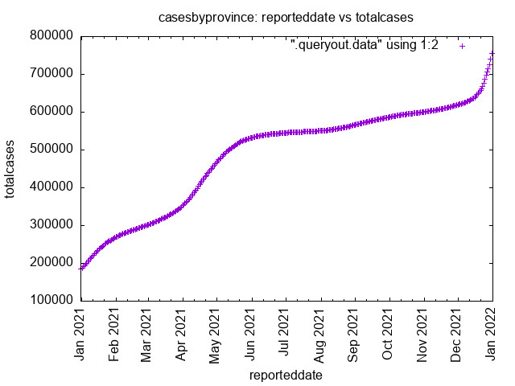
Plotting Script (plot.sh)
Another custom script
Script asks for user input for x and y data columns
Generates .jpg file using gnuplot GUI program program on the CS server
Example output on right

Slide 17
Limitations
Actual Canadian database used various field definitions causing inconsistencies in:
Age Groupings
Provincial Regions
Health Unit Regions
ICU by Age Group or ICU by Health Region was not available
Our database is limited to 2021 COVID-19 data in Ontario as the school CS server can only support so much
SOLUTION:
The Province table provides the option to expand the data into other province data.
On local servers, there is the option to extract older (2020) and newer (2022) data
SOLUTION:
The Province and the IDHealthUnitByRegion tables were created in order to coordinate all the various data together

Slide 18
05
Queries

Slide 19
Scenarios
QUERY 1: Get the average number of hospitalizations in each province for each month and order the results by province and date.
QUERY 2: Get the average ratio of ICU ventilators in use to total hospitalizations for each month in each health region. Order the results by province, date, and health region.
QUERY 3: Prompt the user to enter an age group. Then, display the total number of people in that age group who have received their first and second dose of the vaccine, grouped and sorted by region and date.
QUERY 4: Assume a COVID outbreak occurred due to holiday gatherings. Find how many ICU cases each provincial region saw during the last 2 weeks of December of 2021 (December 18 – December 31). Order them from most cases to least cases.
QUERY 5: The Omicron COVID variant was first reported in Canada November 28, 2021. Find the percent increase of Ontario COVID cases between November and December of 2021. (or the percent increase over the months).
QUERY 6: Prompt the user to enter an age group. Get the percentage of people who took the first dose and did not take the second dose for each month by age group.
QUERY 7: Prompt the user to enter a column name from CasesByProvince to get the smallest value for each month of the reported column.

Slide 20
Live Demo...

Slide 21
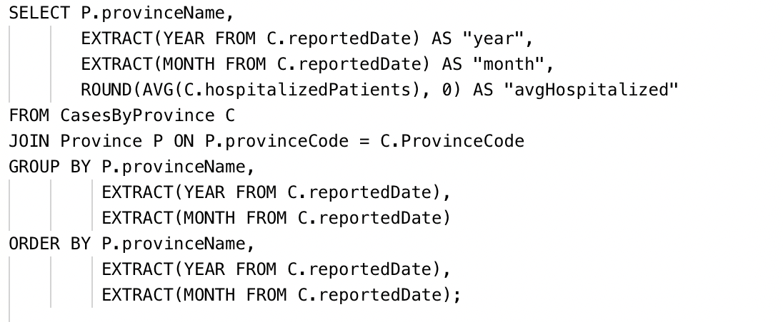
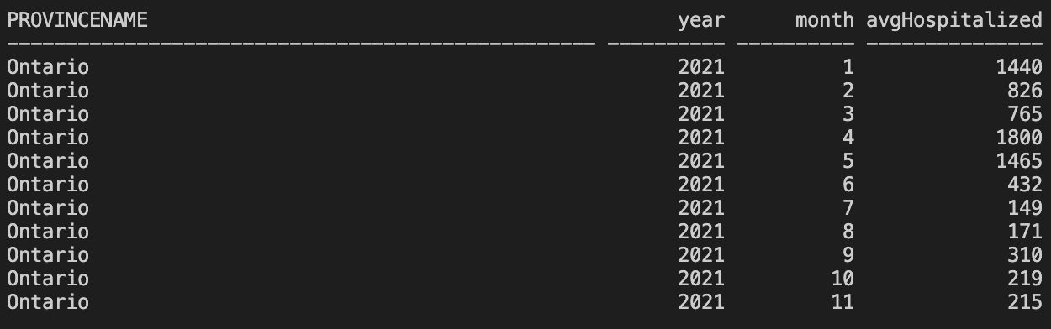
Scenarios
QUERY 1: Get the average number of hospitalizations in each province for each month and order the results by province and date.

Slide 22
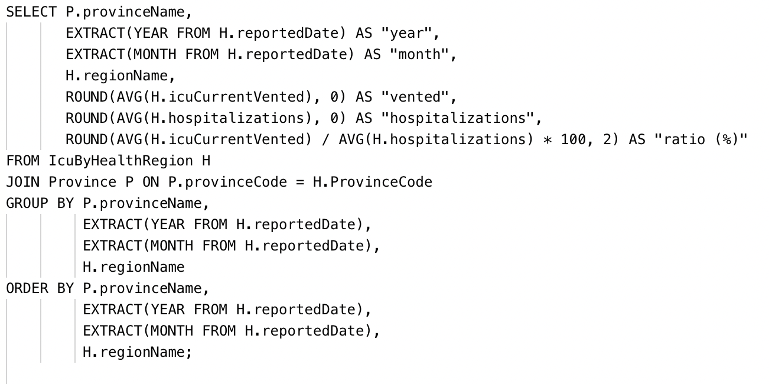
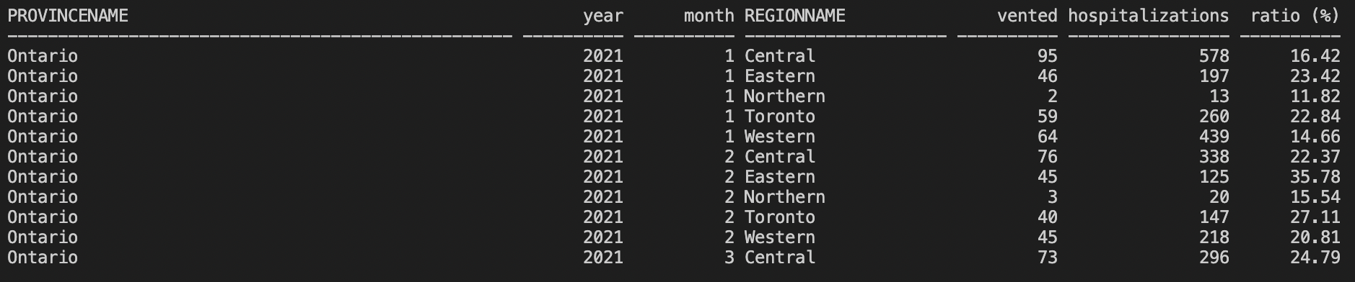
Scenarios
QUERY 2: Get the average ratio of ICU ventilators in use to total hospitalizations for each month in each health region. Order the results by province, date, and health region.

Slide 23
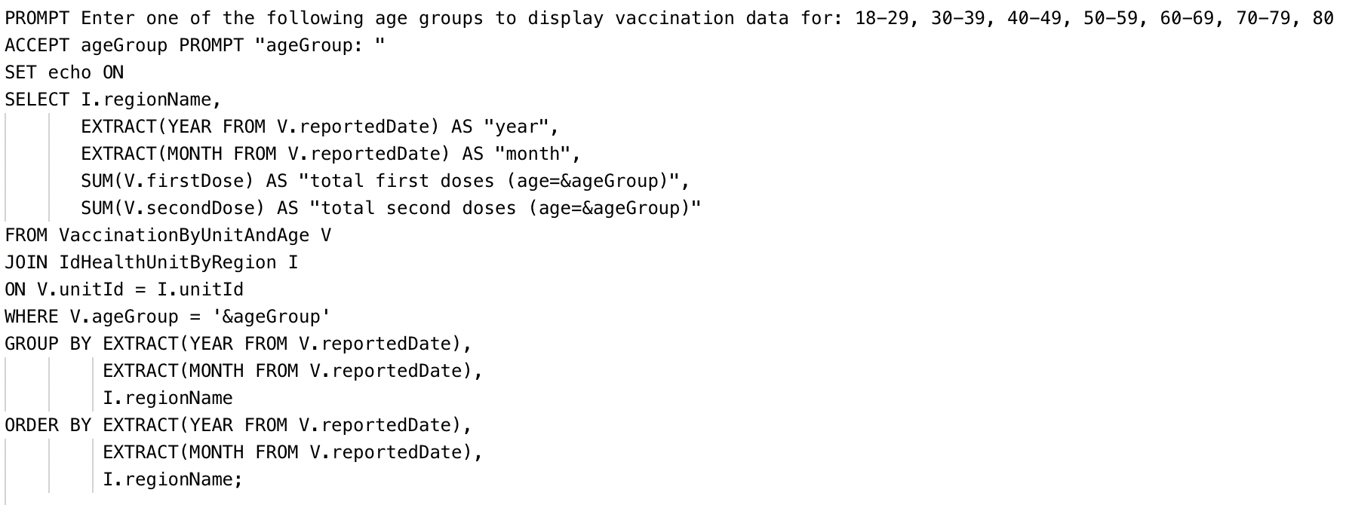
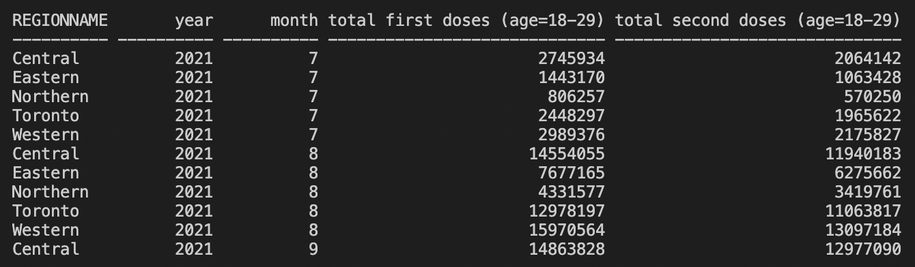
Scenarios
QUERY 3: Prompt the user to enter an age group. Then, display the total number of people in that age group who have received their first and second dose of the vaccine, grouped and sorted by region and date.

Slide 24
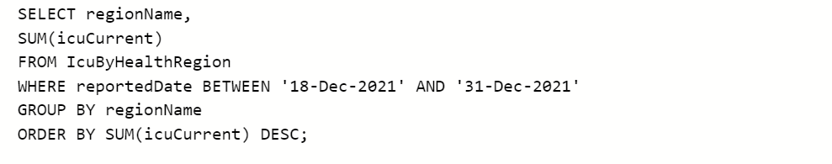
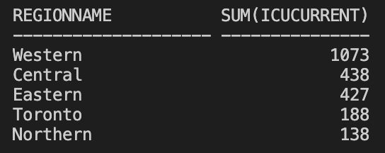
Scenarios
QUERY 4: Assume a COVID outbreak occurred due to holiday gatherings. Find how many ICU cases each provincial region saw during the last 2 weeks of December of 2021 (December 18 – December 31). Order them from most cases to least cases.

Slide 25
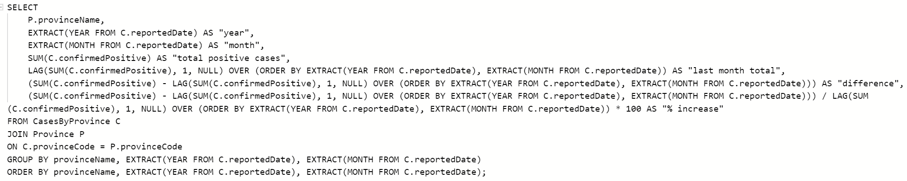
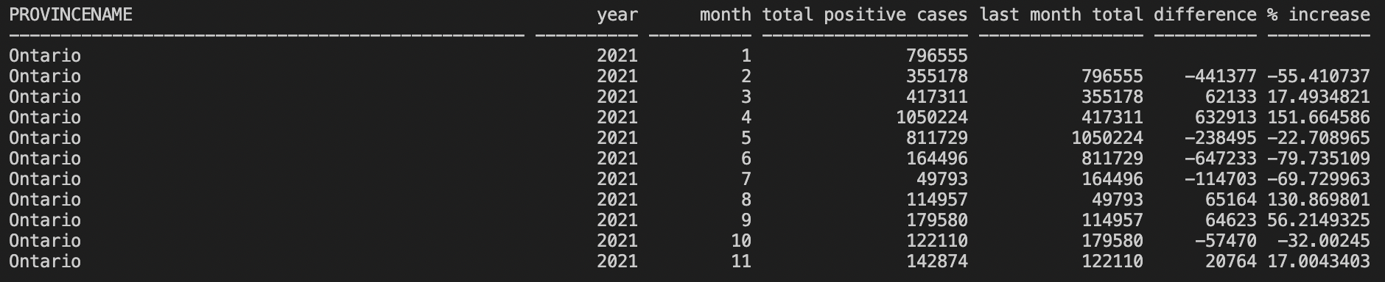
Scenarios
QUERY 5: The Omicron COVID variant was first reported in Canada November 28, 2021. Find the percent increase of Ontario COVID cases between November and December of 2021. (or the percent increase over the months).

Slide 26
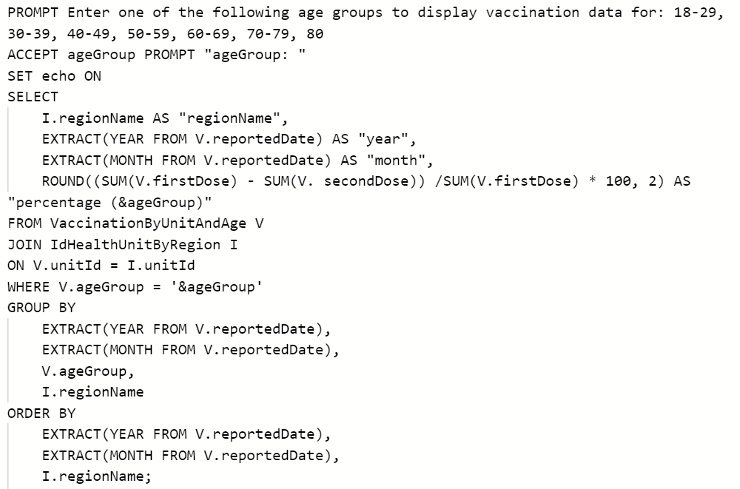
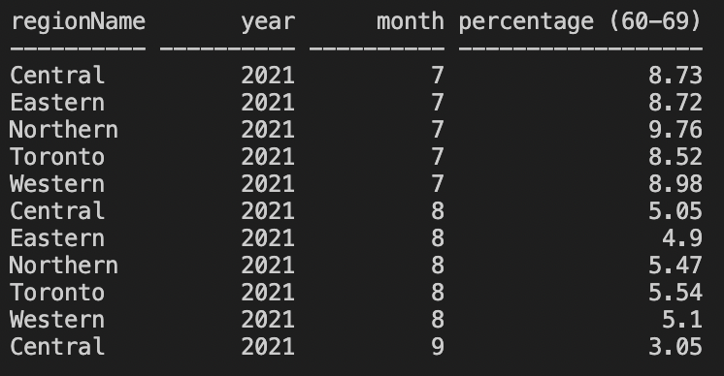
Scenarios
QUERY 6: Prompt the user to enter an age group. Get the percentage of people who took the first dose and did not take the second dose for each month by age group.

Slide 27
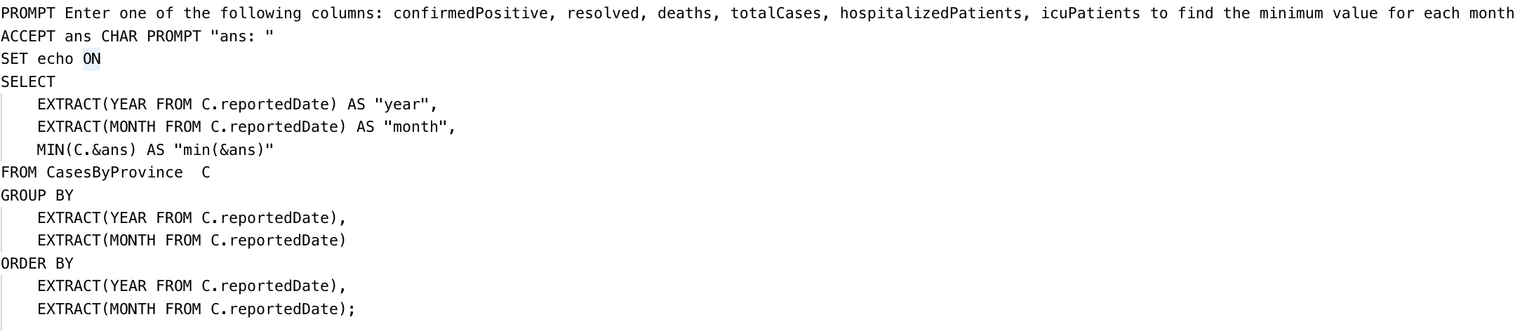
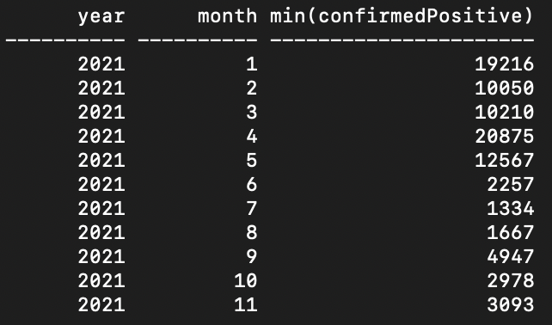
Scenarios
QUERY 7: Prompt the user to enter a column name from CasesByProvince to get the smallest value for each month of the reported column.

Slide 28
THANKS!

